Slide 1
MBA532 – AI in Business
MODULE 4 - AI abilities versus Human abilities, Human/Machine Collaboration

Slide 2
Assessing Human and AI Abilities
Assessing Human and AI Abilities

Slide 3
What are AI abilities?
The history of AI suggests that, to understand AI abilities, it is useful to focus on human abilities, both for benchmarking and comparative assessments.
Historically, AI concept first emerged in the 1950s after Alan Turing (UK Computer Scientist) wrote a paper titled “Computing Machinery and Intelligence” on machines that use available information and reason to solve problems and make decisions.
In 1955, Allen Newell, Cliff Shaw, and Herbert Simon created a program called Logic Theorist, which was designed to copy the problem-solving skills of
a human. It was later presented at the Dartmouth Summer Research Project on Artificial Intelligence a year later. Subsequent developments in NLP (a subfield of AI) mimicked how humans speak and listen, computer vision borrowed from principles underlying how human vision works, and advances in deep learning (that depend heavily on processing across layered artificial neural networks) drew from broad knowledge about human perception, neural processing, and cognition.

Slide 4
How do AI abilities Compare with Human Abilities?
Between 2020-2022, 101 graduate students enrolled in this MBA course on Artificial Intelligence (who averaged three years -- range 3-12 years -- of business experience) - engaged in wide-ranging discussions on the spectrum of abilities considered important to business operations, and compared human abilities with AI abilities.
During class and small group sessions, these qualitative discussions resulted in a continuously curated list of 15 abilities that students agreed as critical to business success. This list on the next slide further explores subsets of these abilities where humans have the greatest potential to excel, and another subset of abilities where AI excels.

Slide 5
Abilities Humans AI-Based Machines
Learn from Experience
Intelligence/common sense
Understand human language
Creative tasks
Judgment tasks
Dexterity/fine motor skills
Rule-bound structured tasks
Boring/Repetitive tasks
Data/Computation tasks
Prediction tasks
Very complex, detail-oriented tasks
Volume of work/tasks
Speed of task completion
Accuracy in completed tasks
Time Horizon on availability
Can Excel
Can Excel
Can Excel
Can Excel
Can Excel
Can Excel
Possible
Difficult
Difficult
Difficult
Difficult
Limited
Limited
Difficult
Limited
Possible (supervised/reinforcement learning)
Impossible
Difficult (NLP limitations)
Impossible
Impossible
Impossible
Can Excel
Can Excel
Can Excel
Can Excel
Can Excel
Can Excel
Can Excel
Can Excel
Can Excel

Slide 6
Technology/Industry Developments that Underpin the AI Abilities List
The 15 abilities identified thus far were validated later by industry experts and practitioners in UK and Italy through focus groups and other qualitative surveys. Abilities identified thus far extended to both humans and AI. It therefore appears appropriate to measure AI abilities in the relative context of human abilities.
The list of 15 abilities that students initially identified as AI dominant (blue box in previous slide) characterized computing and other important technological domains.
In an influential book, Siebel (2019) identifies four key technologies that both drive and enable digital transformation: Elastic cloud computing, Big Data, AI and IoT. Consistent with this premise, in addition to possessing computing abilities, AI systems are infused with architectural, scale, access, speed, and instant communication capabilities that are derivatives of the three other technologies listed above.

Slide 7
Research Insight from another study – It is better to assess abilities through focus on tasks
Martin Fleming (2020) Research in Harvard Business Review (2020)
This study analyzed 170 million online job posts between 2010 and 2017, and is based on the following insight: while occupations change slowly — over years and even decades — tasks become reorganized at a much faster pace because each job represents a collection of tasks. Findings include:
2.5% of jobs have a high proportion of tasks suitable for machine learning. These include positions like usher, lobby attendant, and ticket taker, where the main tasks involve verifying credentials and allowing only authorized people to enter a restricted space.

Slide 8
Research Insight from another study – It is better to assess abilities through focus on tasks
Martin Fleming (2020) Research in Harvard Business Review (2020)
salaries should reflect the shifting value of tasks all along the organization chart. As technology reduces the cost of some tasks because they can be done in part by AI, the value workers bring to the remaining tasks increases. Those tasks require grounding in intellectual skill and insight—something AI isn’t as good at as people.
In high-wage business and finance occupations, for example, compensation for tasks requiring industry knowledge increased by more than $6,000, on average, between 2010 and 2017. By contrast, average compensation for manufacturing and production tasks (more susceptible to automation) fell by more than $5,000 during that period. As AI continues to reshape the workplace, business leaders who are mindful of this shifting calculus will come out ahead.

Slide 9
Scale Development - focus on Tasks
Scale Development – focus on tasks

Slide 10
What are the 15 AI abilities included in our Scale?
Ability to learn from Experience (supervised learning, reinforcement learning) – (LEAEXP) | Ability to execute structured tasks (established tasks with known rules) or unstructured tasks (those that are new or unknown) – (TASKST) | Ability to complete processing tasks at high speed – (HSPEED)
Ability for practical understanding or common sense (PSENSE) | Ability to complete repetitive, boring or hazardous tasks (unattractive tasks) – (UNATTR) | Ability to be accurate in processing tasks (ACCU)
Ability to understand human language (LANG) | Ability to complete data or computation tasks (DCTASK) | Ability to be available over an extended time horizon – (AVTIME)
Creative ability (CREAT) | Ability to complete prediction tasks (PTASK) | Ability to handle very high task volume – (HTVOL)
Ability to handle judgement tasks (JUDGMT) | Ability to complete very complex, detail-oriented tasks (VCDOT) | Ability for tasks that require dexterity or fine motor skills – (DEXT)

Slide 11
Initial Tests to validate our AI Abilities Scale
Scale Refinement Test for AI Ability Items
Following standard procedures to develop the proposed measurement scale for AI abilities by focusing on tasks, the authors developed an initial set of 99 items. To test this scale, we recruited 120 respondents (IT professionals, computer scientists, and experts in AI) in UK through a market research firm in October 2022. They responded to our list of 99 measurement items using a Likert scale.
Following a factor analysis of the data collected in this testing exercise, we eliminated weak items (with low factor loadings, or loadings on multiple factors). This resulted in a shorter measurement scale containing 69 items i.e., four items for each of the 15 AI abilities, and nine items to measure AI contribution to business and AI-HI contribution to business (identified later as the construct labeled AIHICTB).

Slide 12
Empirical Testing of the AI Abilities Scale Instrument
January 2023 Large-Scale Survey of US Adults reflecting US Census
Using Qualtrics platform, we administered a survey to test the AI Abilities Scale and the related nine coordination items to a representation sample of US Adults.
891 US adults responded to this survey. Analysis of this survey database follows.
This database was used to estimate and validate the five-stage business decision-making model (prioritization, rapid diagnosis, preliminary validation/recommendation, AI/Human Collaboration, Business Outcome), on the next slide using structural equation modeling as the research method.

Slide 13
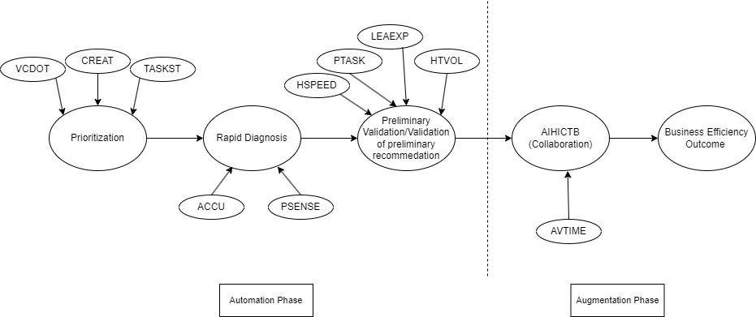
Model Estimated and Validated
Abilities that were dropped from the above model during estimation
process: language (LANG), judgment (JDGMT), dexterity (DEXT),
unattractive (UNATTR) and data/computation tasks (DCTASK).

Slide 14
Implications for Automation versus Augmentation
Our results contribute new insights that inform recent research on automation and augmentation stemming from increased AI deployment on these fronts.
Automation refers to efforts to enhance process efficiencies e. g., Robotic Process Automation (RPA). Automation may fully replace humans who previously worked on boring/repetitive/dangerous tasks, and represent low-hanging fruits in the early stages of AI adoption.
Augmentation refers to AI contributions that specifically augment or supplement human abilities through AI/Human collaboration. Collaborative Robots provide a great example of this, where AI deployment seamlessly works with humans in man/machine teams such that the efficiency gains are significantly higher than in situations that do not require teamwork involving humans/machines. Thought leaders in the AI field have predicted a very robust growth in the augmentation area in future.

Slide 15
AI Abilities dropped during model estimation process – potential explanations
Five AI abilities (language, judgment, dexterity, unattractive and data/computation tasks) were excluded from the final model results.
A plausible explanation is that, as LLMs acquire multi-modal and other sophisticated capabilities (such as RAG or retrieval augmented generation), it is likely that language and judgment skills have already reached the point of equivalency between humans and AI systems. For example, AI systems like GPT-4 successfully passed high school science exams, LSAT, US Medical Licensing exams, after training on content from appropriate textbooks and study guides.

Slide 16
AI Abilities dropped during model estimation process – potential explanations
A machine that eventually understands subtle nuances of the human language may quickly acquire vast quantities of stored human knowledge, thereby leapfrogging tens of thousands of years of learning by more than one hundred billion people who lived on earth. So this clearly appears an essential step toward AGI.
Regarding dexterity, it is likely that its importance is limited to very specialized robot tasks, such that it represents only a minimal part of the overall impact on Business Efficiency Outcome.
For unattractive and data/computation tasks, given the current sophisticated state of AI evolution, it is likely that survey respondents’ associated those with the domain of General Purpose Computing rather than Accelerated Computing that better characterizes AI abilities.

Slide 17
Technology basis for AI abilities and execution of business tasks
In our research study, what AI abilities contribute to automate business decision making?
Within the business decision making domain of automation, we find that abilities such as VCDOT, CREAT and TASKST contribute to Prioritization; ACCU and PSENSE help in rapid diagnosis; and HSPEED, PTASK, LEAEXP and HTVOL develop recommendations.
Consider AI Tools that go beyond performing general tasks (associated with General Purpose Computing and traditional computing abilities) to revolutionize tasks (more associated with Accelerated Computing and AI abilities). Examples include powerful AI Tools such as Tensor Flow, PyTorch, IBM Watson help in rapid and flawless task execution; Google’s AutoML, Amazon’s SageMaker rapidly train high quality Machine Learning models.

Slide 18
Technology basis for AI abilities and execution of business tasks
When AI ability contributes to augment business decision making?
In out study, AVTIME contributes to AIHICTB (i.e., AI and Human Collaborative Contribution to Business Operations).
In their book titled All In on AI, Davenport and Mittal (2023) observe that such collaboration between AI and Humans improves business outcomes. Collaboration opportunities abound especially where AI augments human abilities to improve business outcomes.
Consider examples such as: the OpenAI Energy Initiative, where Microsoft, Shell, C3.AI, and Baker Hughes formed a strategic alliance to create an AI-focused app store for the process industry in the energy sector. Such applications/developments elevate AI abilities to a more central and collaborative role with human decision makers.

